Slide 1
Solar Energy Management System with IoT
텍스트를 입력하십시오
Ways to interact and maintain solar energy sources from many miles away…
Preject #4
Jiacheng Wang, Bumjun Oh, Hanbyeol Lee, Hyeongyu Lee, Sangje Jeong

Slide 2

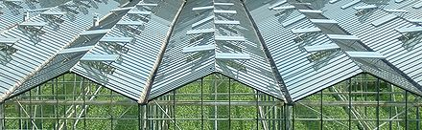
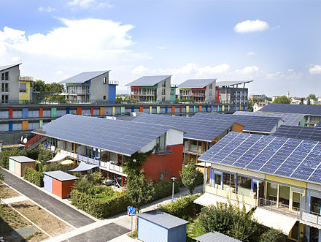
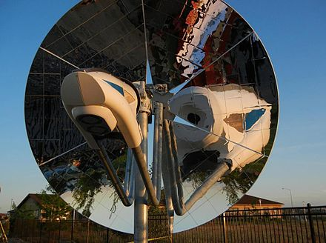
Introduction to Solar Energy
What is solar energy?
Solar energy is radiant light and heat from the Sun
Harnessed using a range of ever-evolving technologies
solar heating
photovoltaics
solar thermal energy
solar architecture
molten salt power plants
artificial photosynthesis
"Solar Energy Perspectives: Executive Summary" (PDF). International Energy Agency. 2011.

Slide 3
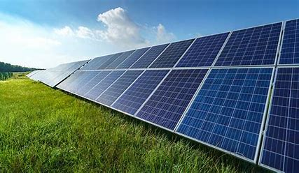
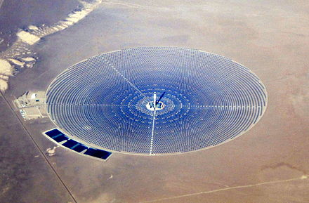
How can solar energy produce electricity?
Photovoltaics(PV) vs. Concentrated Solar Power(CSP)
Use Solar Cells to generate electricity
Cluster of solar cells make up solar panels
Convert sunlight into electricity
Use mirrors/lenses in vast area to concentrate sunlight onto a receiver
Convert sunlight into heat, heat into motion, motion into electricity
"How CSP Works: Tower, Trough, Fresnel or Dish". SolarPACES.
Notes:
Solar Energy Pros and Cons
-Advantages
No danger of exhaustion.
Safe and reliable, no noise, no pollution emissions, absolutely clean.
It is not limited by the geographical.
Electricity can be generated and supplied locally without consuming fuel and erecting transmission lines.
The construction period is short, and the time it takes to obtain energy is short.
High energy quality
-Disadvantages
The production of solar panels has the characteristics of high pollution and high energy consumption.
The distribution density of the irradiated energy is small, that is, it takes up a huge area.
The energy obtained is related to meteorological conditions such as four seasons, day and night and rain or shine.
Compared with thermal power generation, the opportunity cost of power generation is high.
Photovoltaic panel manufacturing process is not environmentally friendly.

Slide 4
Photovoltaic(PV)
Features and Downsides
Structure and Potential hazards

Slide 5

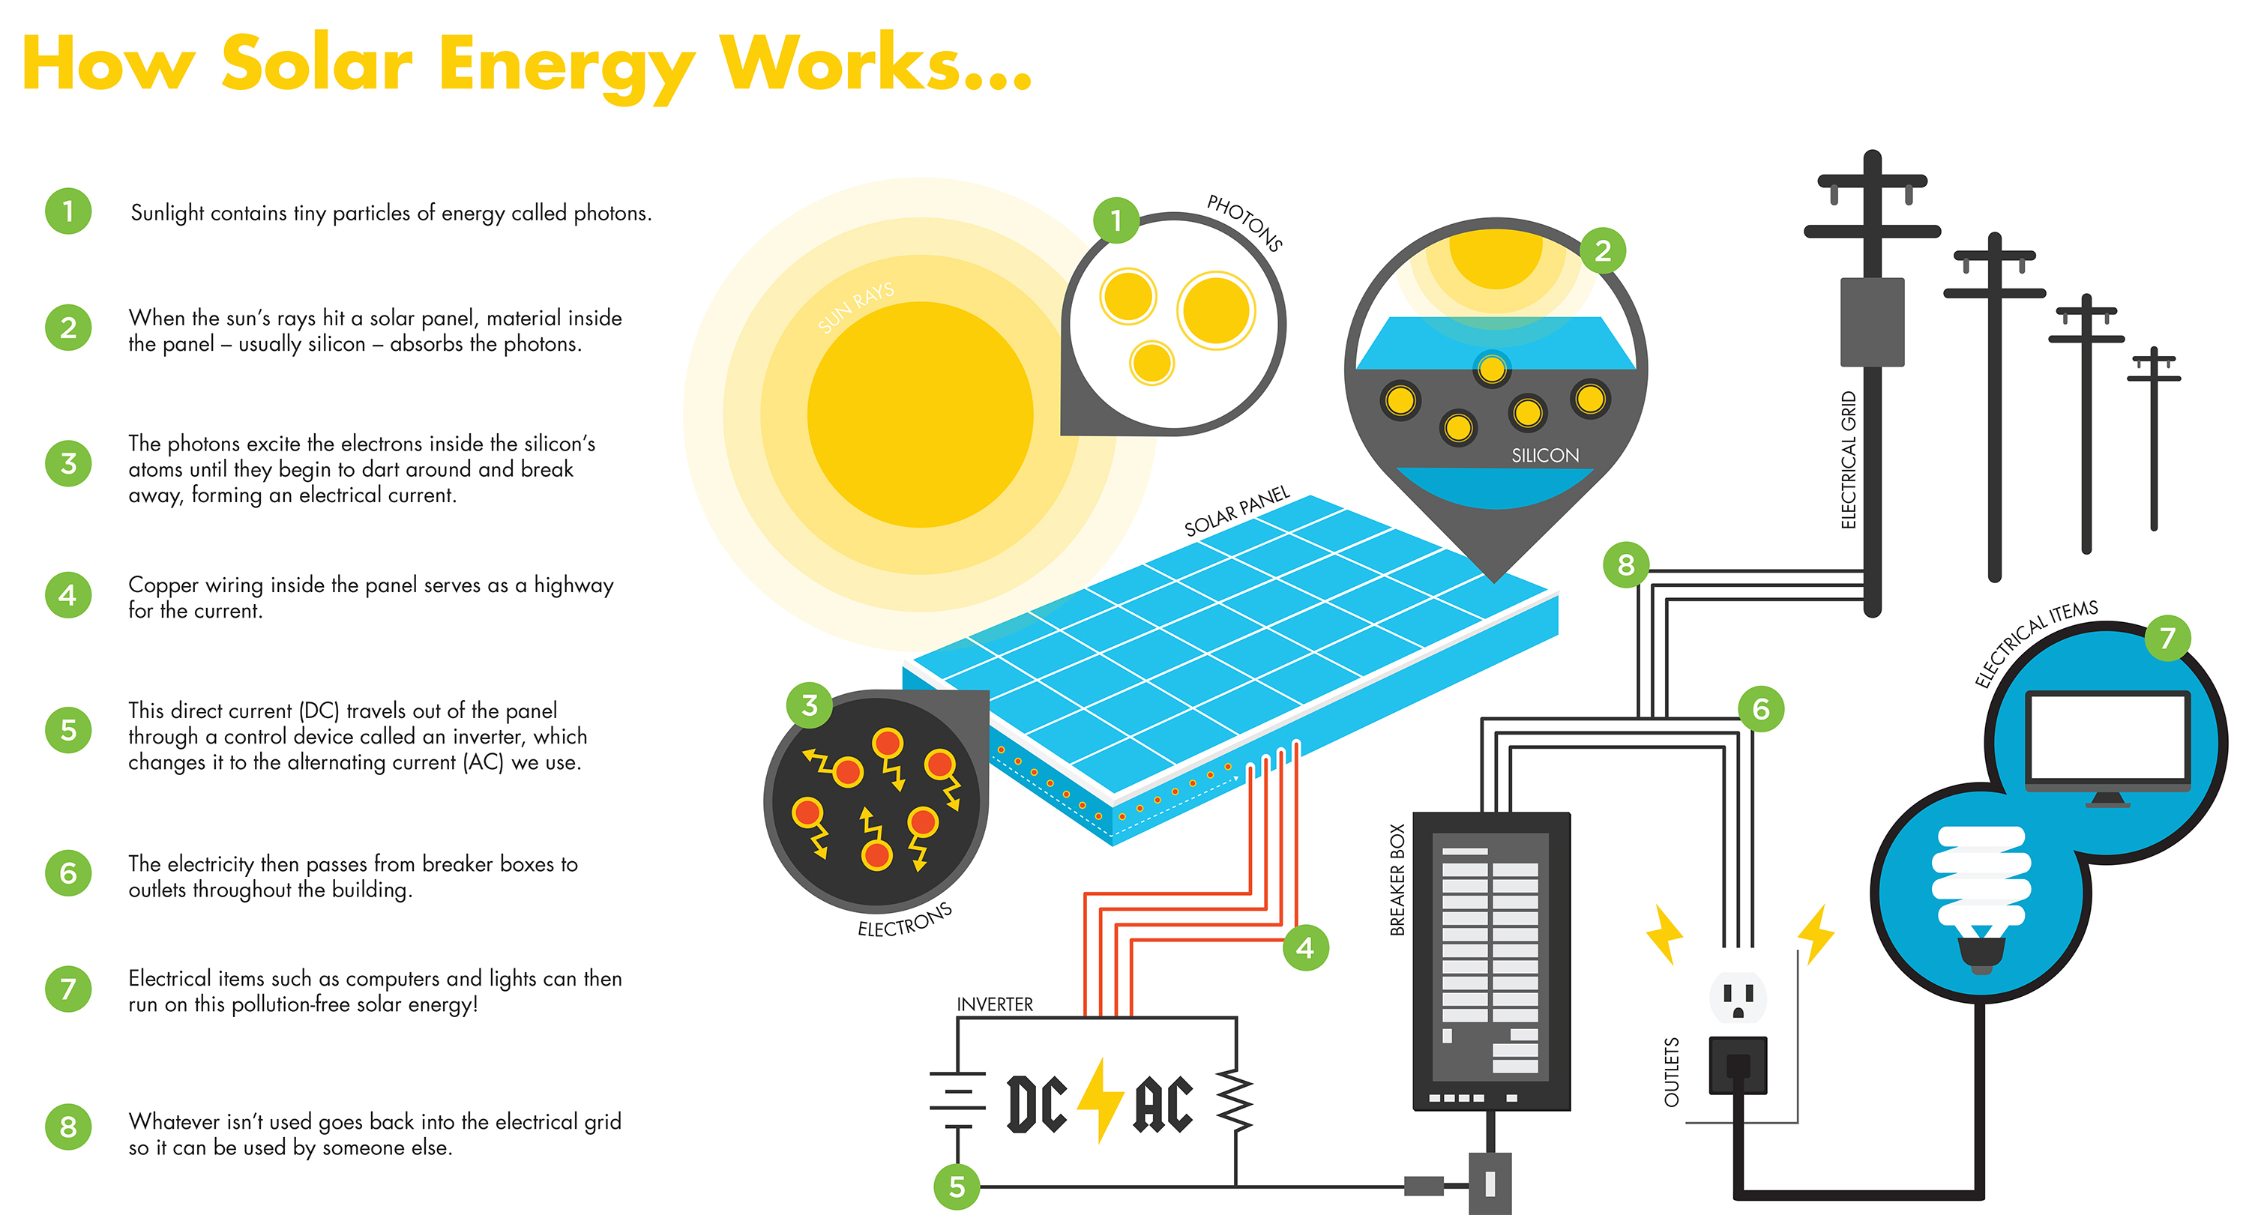
Structure of PV solar energy production

Slide 6
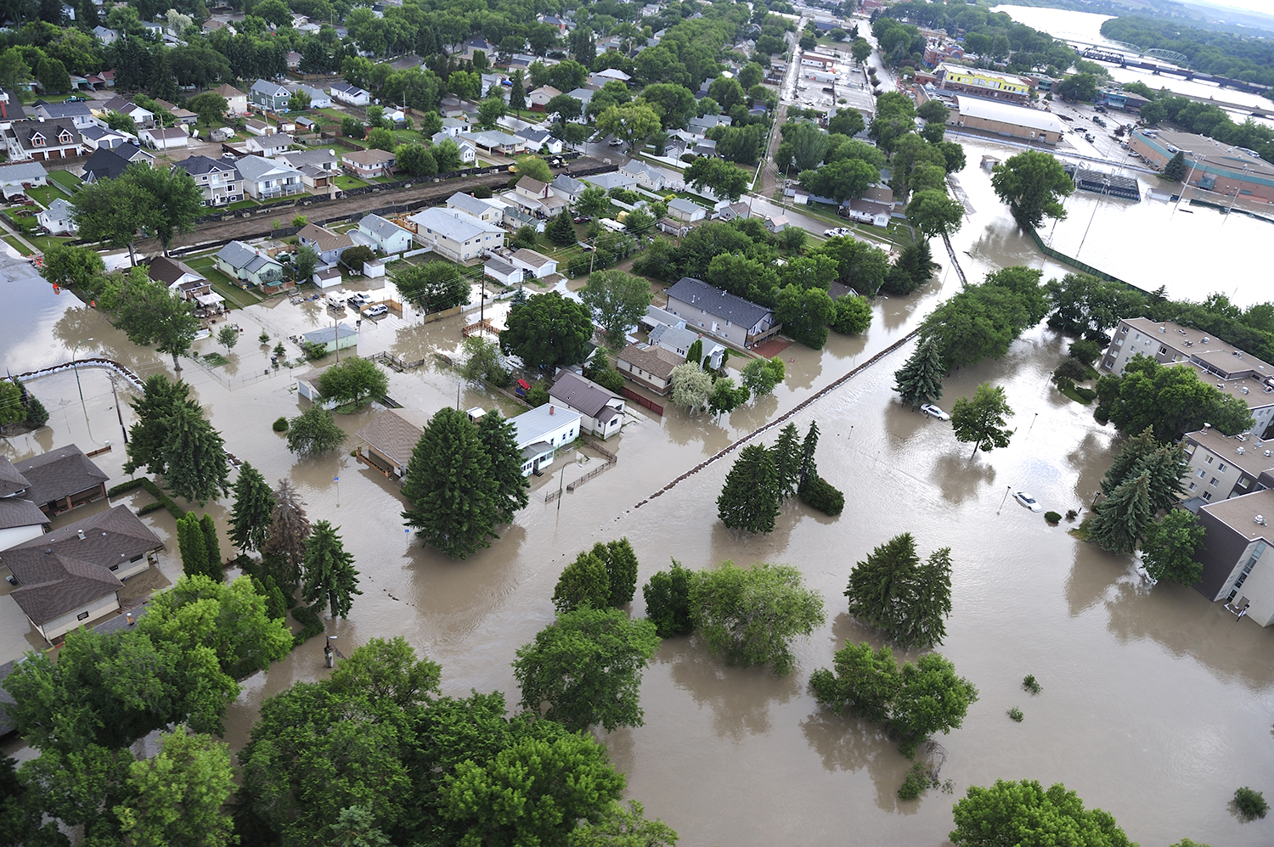
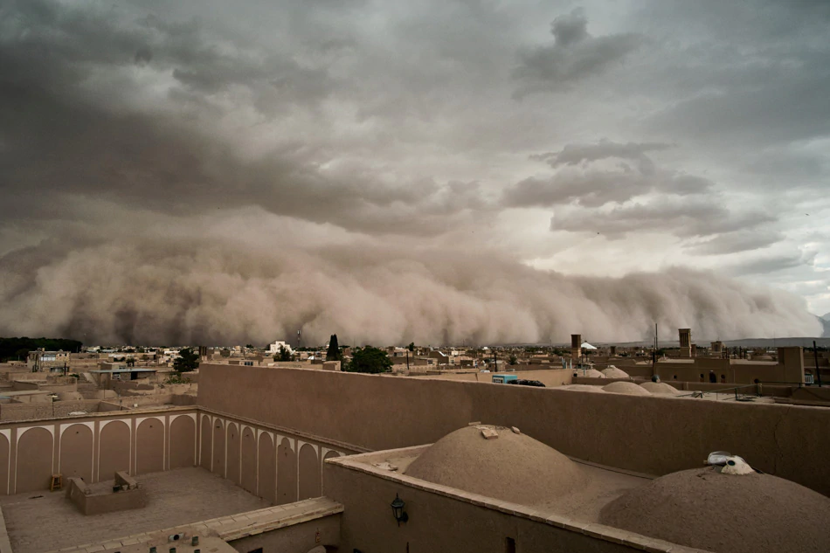
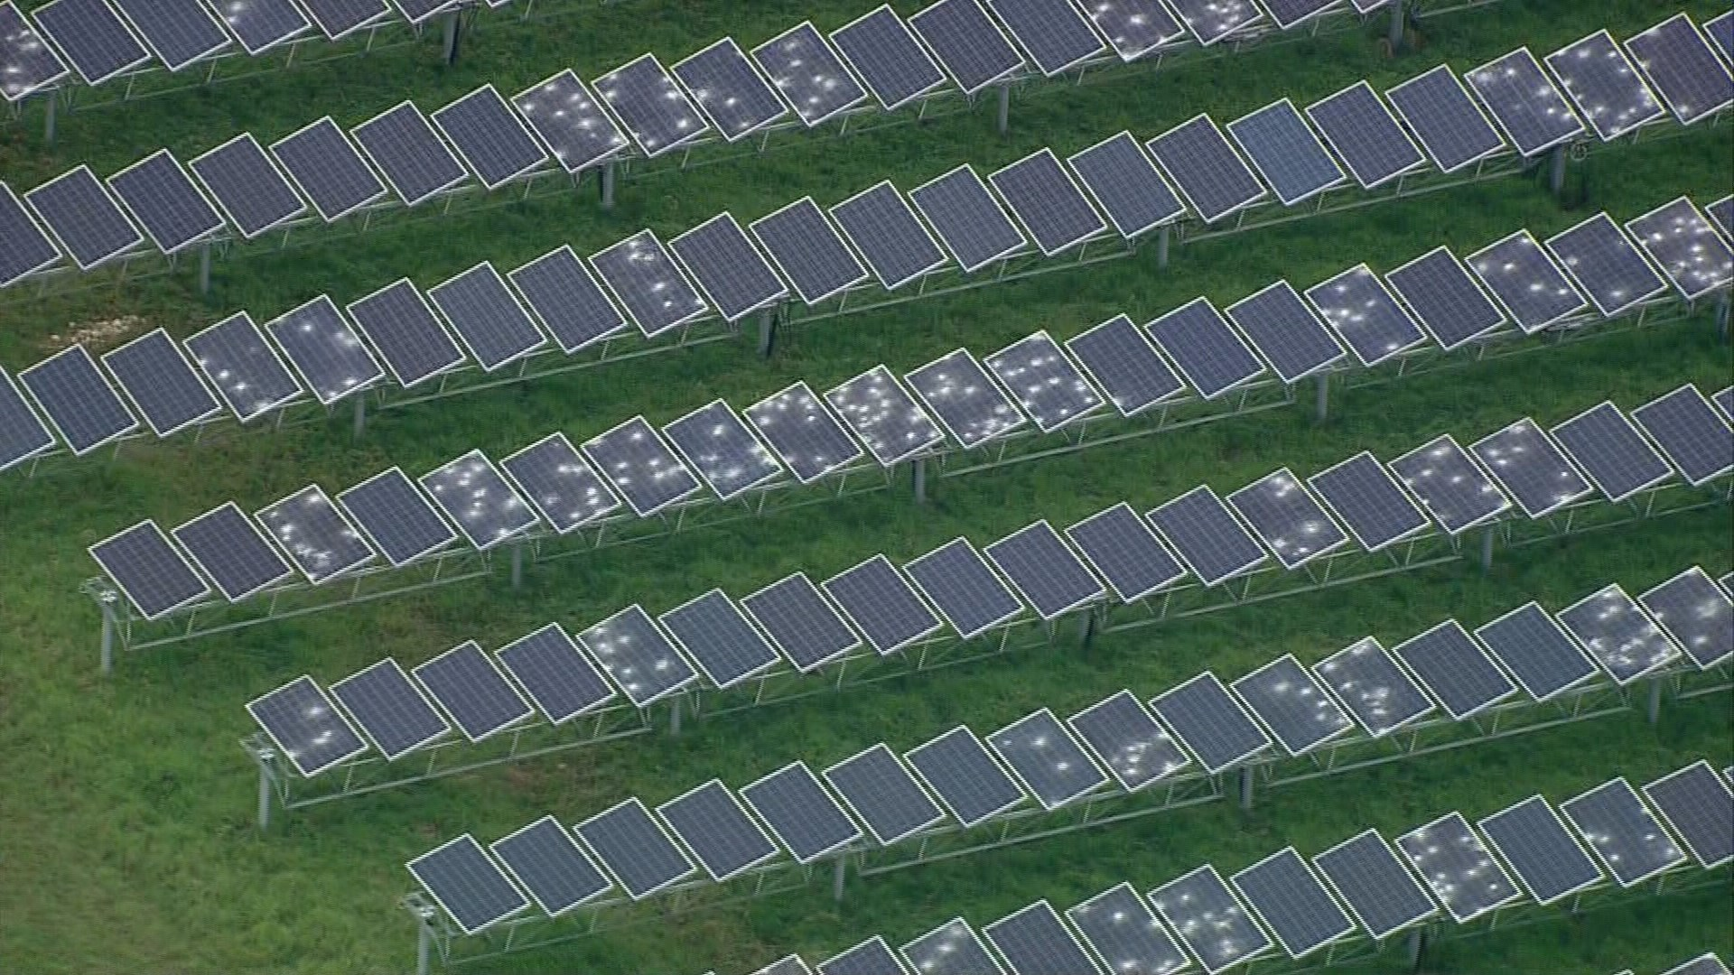
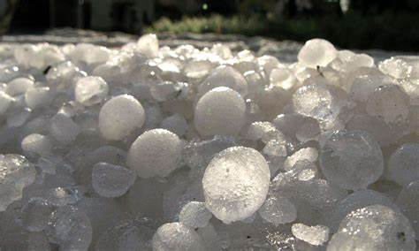
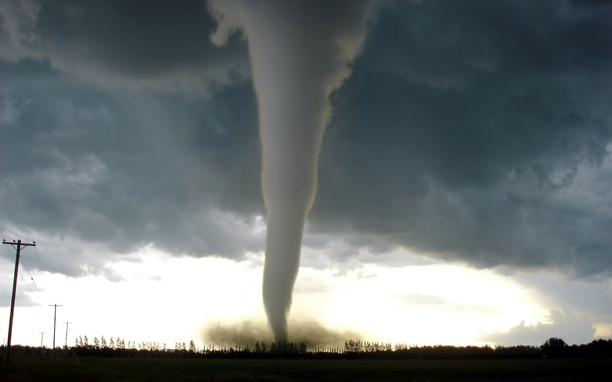
Downsides
Natural causes, malfunctions and many more…
It’s not 100% reliable…
Natural disasters can cause damage to the panels
Sandstorm
Hail
Storm
Tornado
Flood
Defects found later since production
Etc…

Slide 7
Main issue
Lifespan
Prevent
Problems
Solving
Prototype

Slide 8
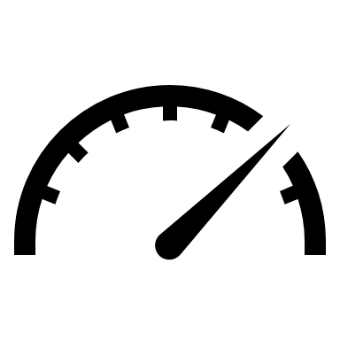



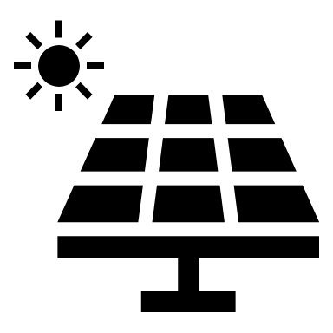




How to monitor and prevent potential problems?
Cooperation with IoT devices!
Monitor the production of electricity 24/7
Receive weather forecast information in the area of the installation
Surveillance camera to send photo hourly
Use GPS sensors to indicate the locations of each device
Etc.

Slide 9

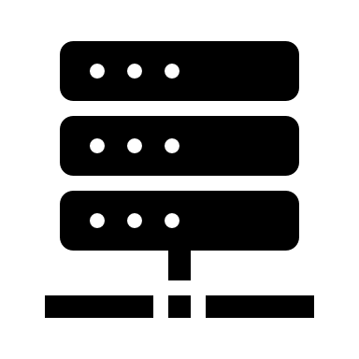
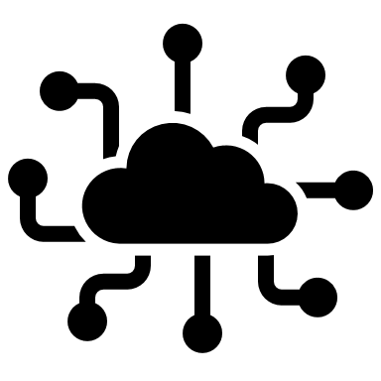





Abstraction of IoT device and its sensors
data
GPS device
data
IoT company/platform
data
Temperature
/humidity
monitoring
device
data
control
control
Analytics
IoT Hub
control
The Internet
data
control
camera
data
IoT Remote
Power measuring devices

Slide 10
Problem! : Different Lifespan of power generation
Solar generation
Solar panel 25~30 years
Solar charge controller. 15 years
Battery 17 years
Power inverter 25 years
Wind generation
Rotor blade 10~20years
Blade pitch control
Rotor hub

Slide 11
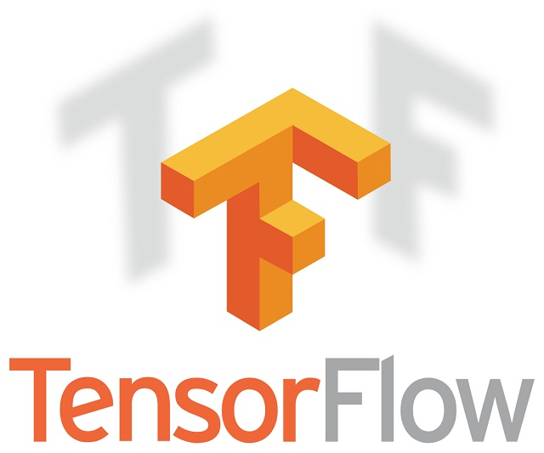
How to solve the problem
We want to use A.I. to analysis each generation environment to predict the lifespan of parts.
There is a possibility that there is a difference in the lifespan of the same part due to a decrease in precision in the process of the product, but we hypothesized that the difference in the power generation environment has a big effect.
Ex : The rotor’s lifespan of wind power generation is closely related to the number of rotations of the rotor.

Slide 12
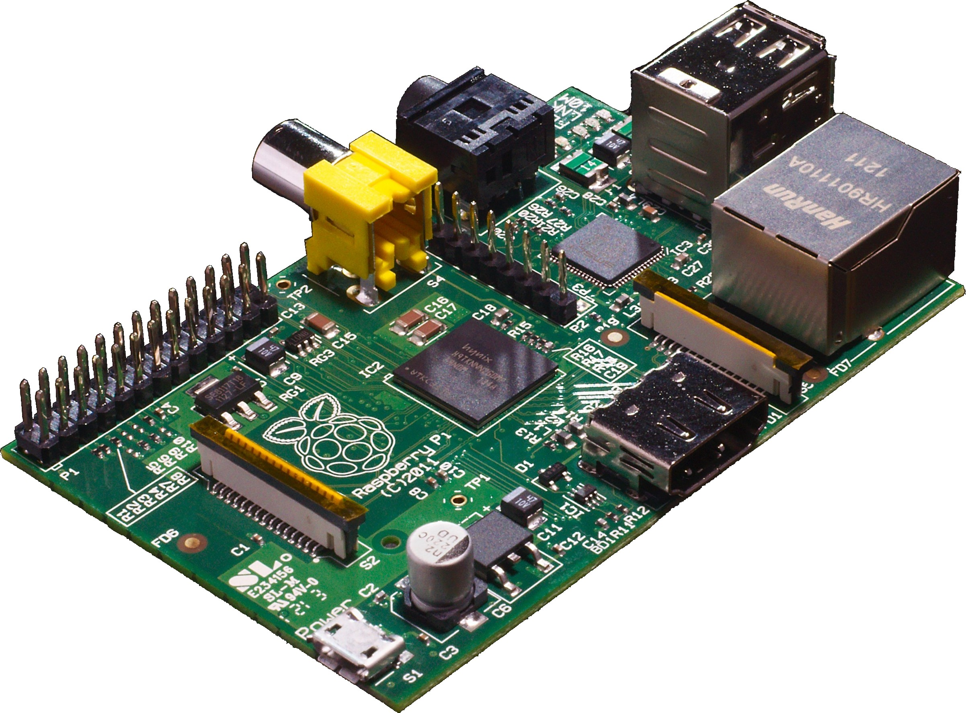
Plan to make a prototype
Make a virtual power generation environment through small parts that we can procure.
Analysis each generation’s environment to A.I. at raspberry Pi.
Predict each component’s lifespan of each environment and Control the traffic

Slide 13
Processes
Lifespan
Data Measurement
Data Transfer
Data Analyze
Data Visualization

Slide 14
Data Measurement

Slide 15



Power Measuring Device
Measuring power production with ammeter and voltmeter
Power supply
charge
Battery
DC
AC
Solar panel
DC to AC Inverter
Breaker Box
Electricity measuring devices
(ammeter, voltmeter, etc.)
data
IoT Hub
Notes:
Solar panel
Use sunlight as a source of energy to generate direct current electricity
Life span : about 25 to 30 years
Solar charge controller
A charge controller or charge regulator is basically a voltage and/or current regulator to keep batteries from overcharging. It regulates the voltage and current coming from the solar panels going to the battery.
Life span : about 15 years
Battery
Many types of batteries are used(lead acid battery, lithium battery, Nickel hydride battery, Nickel cadmium battery). But, in general, lead-acid batteries are widely used, because it is inexpensive.
Life span : about 17 years
Power inverter
The inverter converts DC power to AC power, and also changes the voltage.
Life span : about 25 years

Slide 16
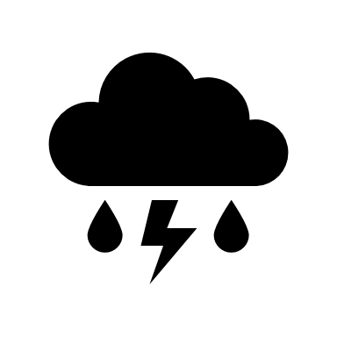
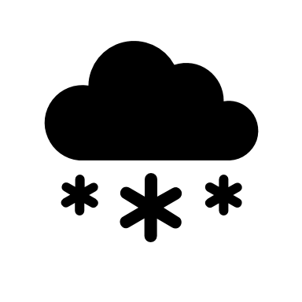


GPS tracking device
Solar power plant could be a vast area…
We need to locate each or group of panels for easier maintenance…
GPS device
GPS device
GPS device
GPS device
GPS device
IoT Hub

Slide 17

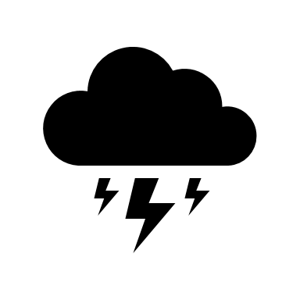
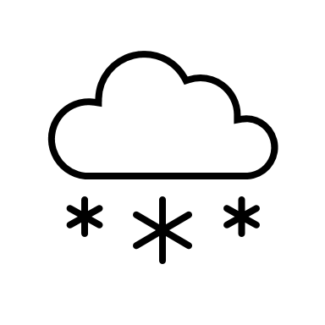
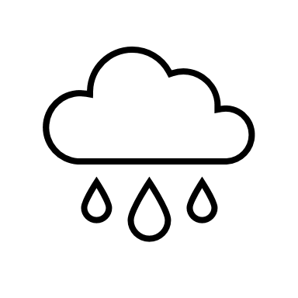


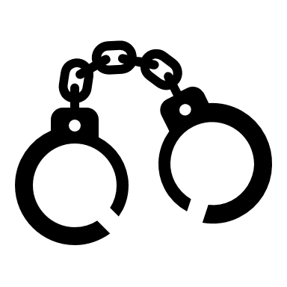



Visual Devices
Purpose for capturing surrounding area and the health of solar panels
meteorological phenomena
vandalism
Interference of wildlife
IoT Hub
Notes:
Cameras taking pictures at

Slide 18


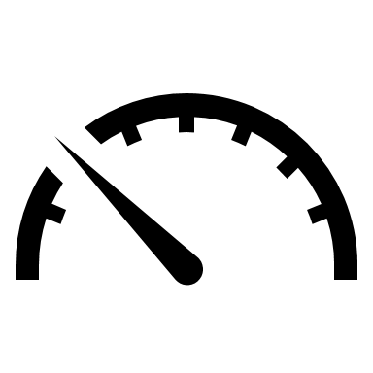


Temperature/Humidity monitoring devices
High temperature and high humidity lowers the efficiency of power production
IoT Hub
Notes:
The temperature of the solar panel affects the maximum power output directly.
As a solar panel's temperature increases, its output current increases exponentially while the voltage output is reduced linearly.
Since power is equal to voltage times current, this property means that the warmer the solar panel the less power it can produce.
Studies have shown that cell work in high air temperature and high humidity conditions causes a significant reduction in cell efficiency.
High relative humidity also has negative effects on solar radiation and reduces cell performance.
Real time data of current temperature and humidity with power production, can show relations between them and be used as
Reference data for later.

Slide 19
Data Transfer

Slide 20
Data transfer using rasberry pi
Accept datas coming in from "Data Measurment Processes"
Ex) Solar panels, electirycity, temperature, gps info
Refine the Data , send it to both server, cloud storage for data analyzing, data storing

Slide 21
Data Analyze

Slide 22

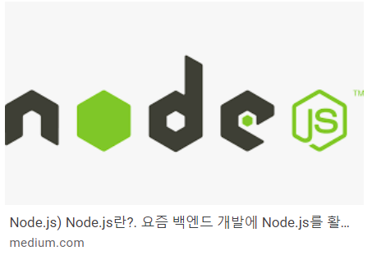
Data Analyze ( Backend Server, TensorFlow )
Will use the datas stored in Cloud Storage, datas sent from IOT
Will analyze the data and get result at the backend server

Slide 23
Data Visualization

Slide 24
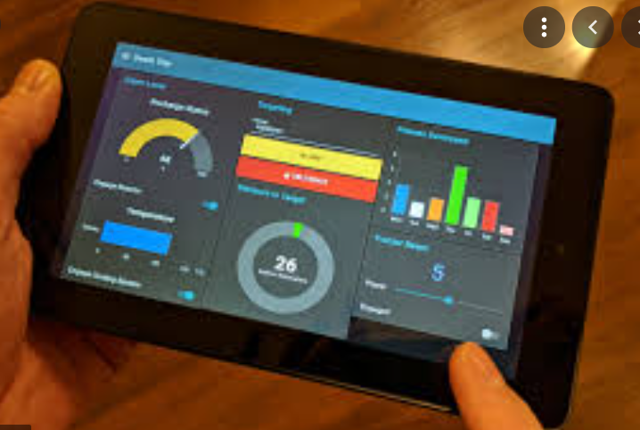
Data Visualization
Will Node Red , other frameworks to display the data anlayzed in the Server
Ex) temperature, amount of incoming electricity per each solar power system, location of solar power system, realtime video of solar power system
Will alert the error if something goes wrong so that user can notice malfunctions in solar power system
Ex) if electricity goes up certain amount, will alert error such as "number 1 solar panel system, located in ~~,~~ has too much electricity coming in "

Slide 25
Hyeongyu Lee
Student of
Chung-Ang University
snicket@cau.ac.kr

